Slide 1
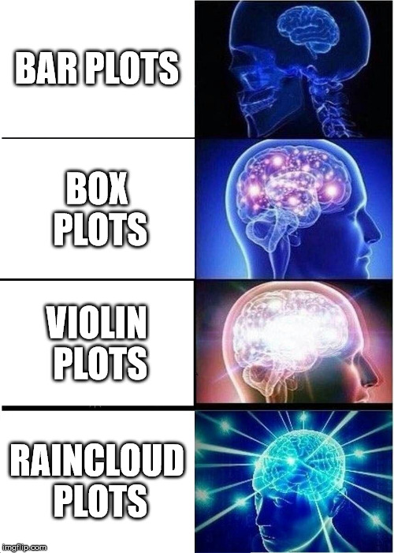
Data Visualization 3
Fancy plots, images, 3D plots

Slide 2
Topics
Introduction: GUI and basic calculations
Coding 1: Scripts, style, and variable classes
Coding 2: Control statements and loops
Visualization 1: Basics, subplots, get and set
Coding 3: Functions
Visualization 2: Descriptive plots
Coding 4: Basic input and output
Visualization 3: Distribution and 3D plots
Coding 5: Input and output specials – last lecture before holidays
Machine Learning 1: Introduction and dimension reduction
Machine Learning 2: Clustering
Machine Learning 3: Classification
Coding 6: Efficiency and debugging basics
Coding 7: Advanced functions and debugging

Slide 3
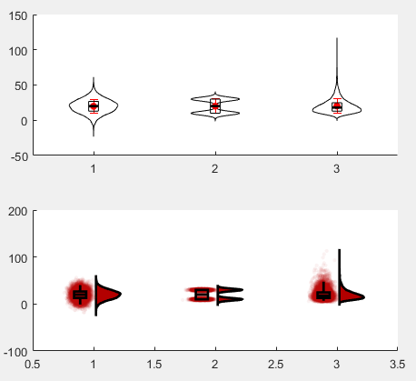
Violin Plots and Raincloud Plots
https://www.ncbi.nlm.nih.gov/pmc/articles/PMC6480976/

Slide 4
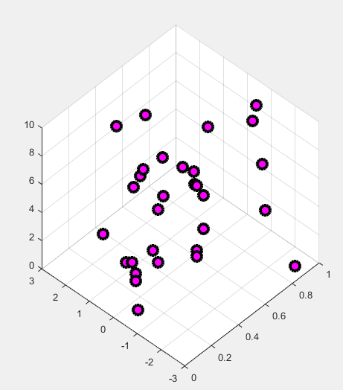
Imaging and 3D Plots

